Slide 1
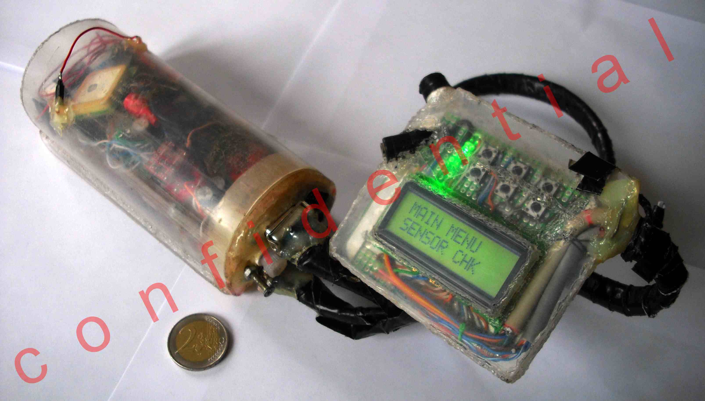
Paragliding assistant computer
V
T
R
1
0
0
0
V.T.R. series
A project by Calin Popa & Ovidiu Ban

Slide 2
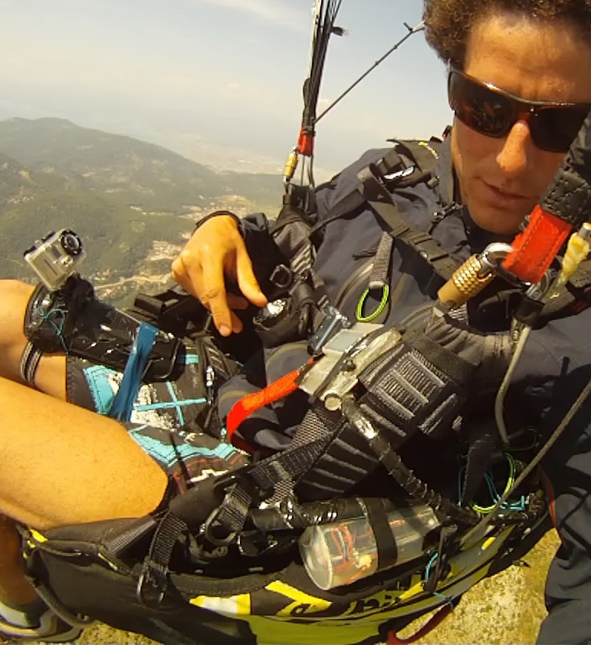
V.T.R. Purpose: A world para-novelty
Primary: In-flight paragliding assistant, telling the pilot what to do during aerobatic or exceptional maneuvers (in-flight incidents), a para-TEACHER;
Secondary: provides information for post flight analysis, using 3-D modeling and dedicated graphical programs;
Pal Takats(world acro champ.) testing the VTR 1000:

Slide 3
V.T.R. series Functioning Principle:
The “robot” measures: acceleration, speed of rotation, 3d compass, GPS, barometric pressure and break force, and then interprets the data on its chip;
The main feedback to the pilot is ACOUSTIC, suggesting the pilot in pre-recorded voice what to do, during his flight;
The function of the “robot” is to : record, analyze and interpret all motion parameters, real-time, during paragliding flight;
Operating frequency: 30 measurements/sec;

Slide 4
Development stage - current progress:
The hardware of the first prototype (V.T.R. 1000) is completed (as seen in pic1). It records data from 10 sensors, divided in 3 modules (main body, glider and harness) and stores on SD card. It is sturdy, reliable and sync with Video cam (GoPro HD);
The data analysis program AGAT 007 displays the data graphically and allows dataflow pattern identification and correlation;
Dozens of test acro flights, fully recorded (development database), also primary in-flight assist functions (pull-release);

Slide 5
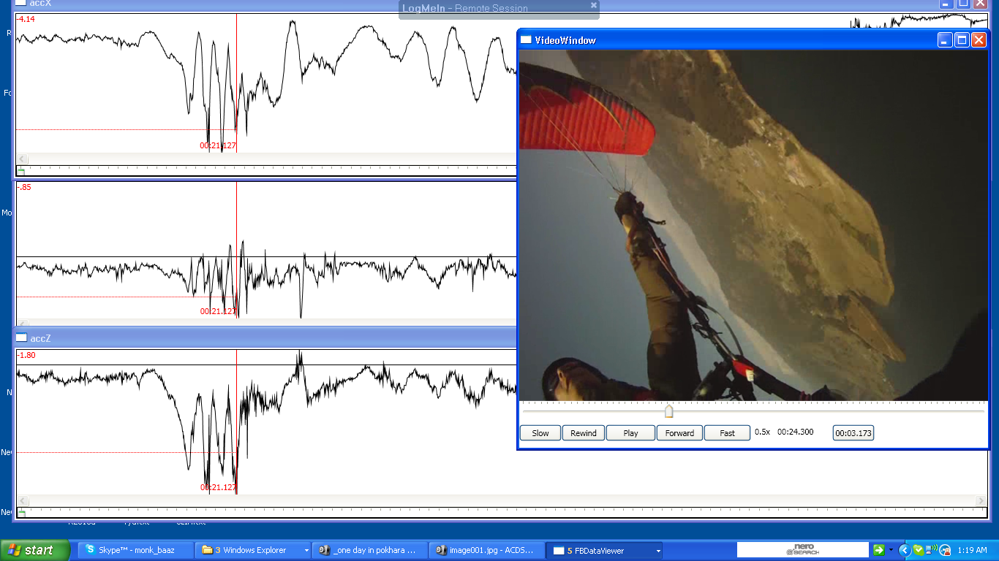
A.G.A.T.: Acro Graphical Analysis Tool
The program sports comprehensive and accurate graphical representation of dataflow;
The data to be shown is selected by user from dropdown menu;
The program has save project, workspace and notes abilities;
The data is fully synchronized with onboard video camera;

Slide 6
In-progress Development:
Extensive study and programming on the physics and mathematical interpretation, for accurate 3D trajectory modeling(full featured dead-reckoning);
The 3-D visual interface tool;
Hardware & software development for V.T.R.2000 (fully wireless, smaller & a LOT more powerful);
Further in-flight testing on V.T.R. 1000;

Slide 7
V.T.R. Benefits and goals:
Increased safety during aerobatic maneuvers training: Up to an estimated 500% improvement;
Customizable TEACHER for aerobatics;
Danger warning for usual flying activities;
Useful tool for safer beginners’ teaching (in schools);
High end paragliding development and prototyping;

Slide 8
Market estimations:
Estimated no. of acro pilots: >4000 (justacro.com);
Estimated no. of paragliding pilots : >100000;
Estimated no. of flight schools: >300;
Minimum retail price (V.T.R. 3000): 2000 EUR;
Collaboration opportunity with glider manufacturers on development and testing of their equipment;

Slide 9
Finances requirements:
New paraglider (U-turn Thriller 17): 1600 EUR
New harness (Sup’Air Acro): 600 EUR
Components for VTR 2000: 800 EUR
Proper testing over lake (1 week Austria): 600 EUR
Development expenses, etc… ???? EUR

Slide 10
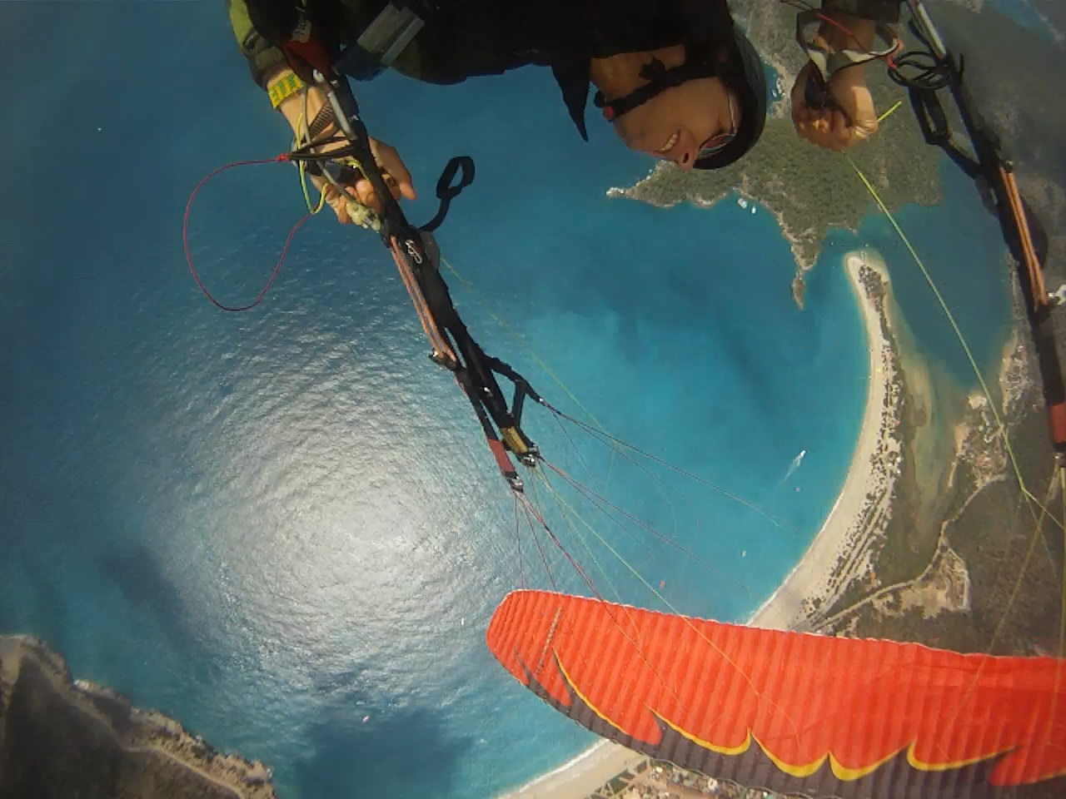
Thank you! Calin & Ovidiu
Check out my youtube channel: “monkbaaz” (Calin)
Watch the video with Pal; Takats testing the robot;
Feedback us with your opinion, financing possibilities and requests!
ovidiuban@yahoo.com
Calin performing Tumbling:

